Slide 1
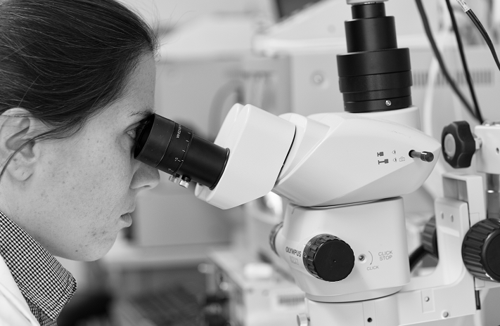
Research position available in Dr. Sam King’s lab at Nationwide Children’s Hospital
We are seeking an enthusiastic and organized critical thinker to join our research group. The focus of our group is streptococcal interactions with host glycan structures. These interactions are critical in colonization of the oral cavity and development of infective endocarditis. We are looking for someone with experience in a range of molecular biology and biochemical skills including bacterial mutagenesis and protein expression. Experience with bacterial binding assays, microscopy, and bioinformatics is a plus. Successful applicants will be expected to present their work and contribute to the preparation of manuscripts. While we are advertising for a Postdoctoral scientist, we would also be willing to hire an experienced research associate (applicants without a PhD would need to contact Dr. King). For more information, please see the job posting link or reach out to Dr. King.
To view the job posting or apply please click the link below:
https://external-nationwidechildrens.icims.com/jobs/26989/post-doctoral-scientist-year-1-3---center-for-microbial-pathogen/job
Or contact Sam King
Samantha.King@nationwidechildrens.org

